Slide 1
Tear Down this Zywall! Breaking Open Zyxel Encrypted Firmware
Notes:
Good evening, DEF CON! And happy 30th!
So how was everyone’s first day? Show of hands, first DEF CON?
That’s great, welcome, glad you’re enjoying it – there’s lots more for you to see tonight, Hacker Jeopardy is here after this, so let’s get started
Zy-Cell

Slide 2
Agenda
Introduction
How it Started
The Firmware
The Hardware
The Software
How it’s Going
Future Work
Questions
@jaylagorio // jay@lagor.io
Notes:
We’ll talk about how I got into this
All the different analysis that went into it
Where that gets us later
And what’s left to do

Slide 3
Introduction
Who’s this moron?

Slide 4
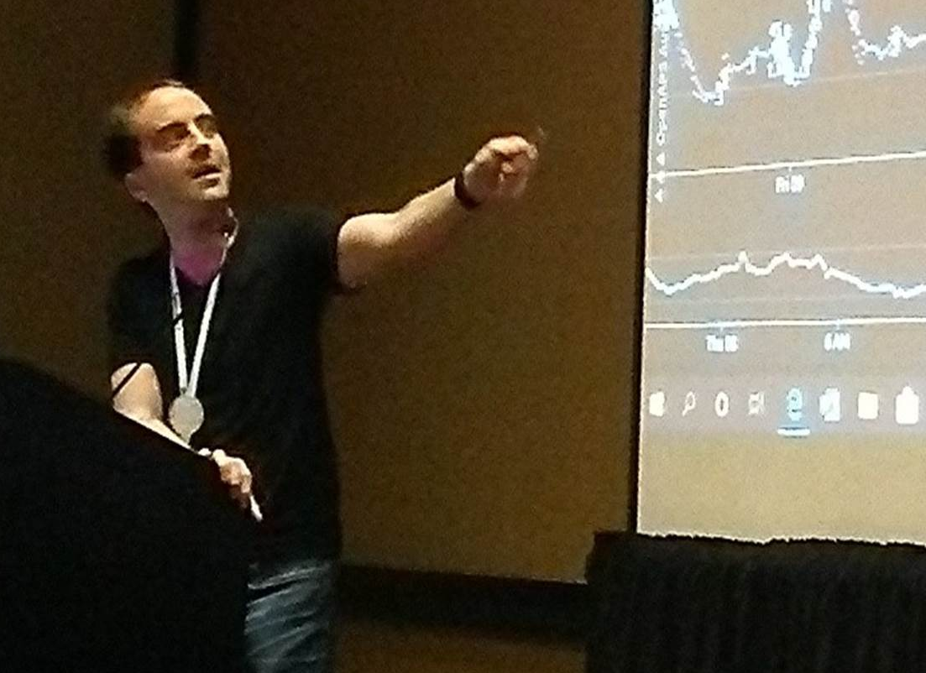
whoami
LAGORIO\Jay (jay@lagor.io)
B.S. Computer Science, UMBC (2008)
M. Eng. Electrical Engineering, NPS (2015)
CISSP, various SANS certifications over the years
Windows Developer, Security Consultant, Licensed Private Investigator
Talks at Hackfest.ca 10, DC27 Biohacking Village, Kernelcon 2
Unrepentant nerd
@jaylagorio // jay@lagor.io

Slide 5
How It Started
There’s backdoors in them thar hills
Notes:
It was December 2020, we all just got through the first year of the plague, and things were looking up! Vaccines were just over the horizon and things were actually looking a little hopeful!
But then like usual it all gets ruined because I got an email.

Slide 6
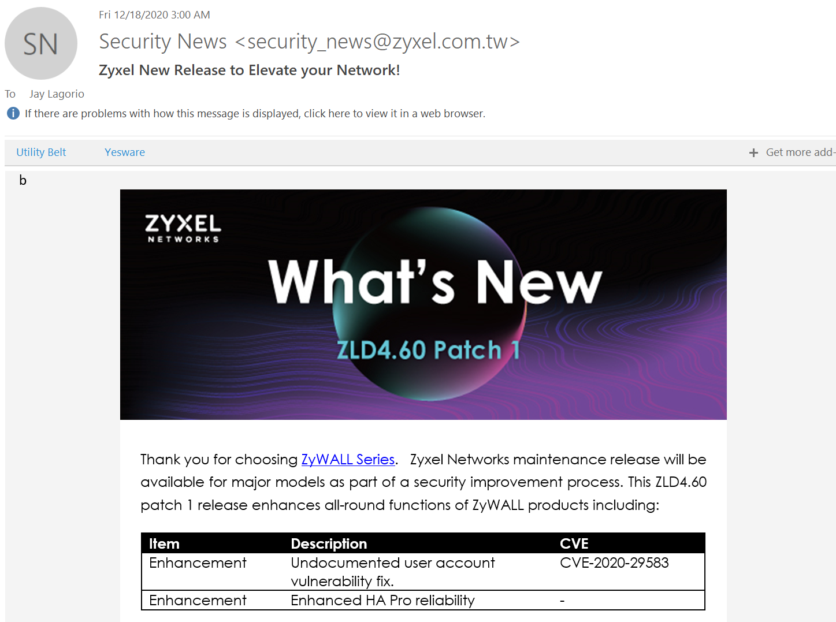
It was December 2020
@jaylagorio // jay@lagor.io

Slide 7

It was December 2020
@jaylagorio // jay@lagor.io
Notes:
So like, you’ve got to be kidding me, right?

Slide 8
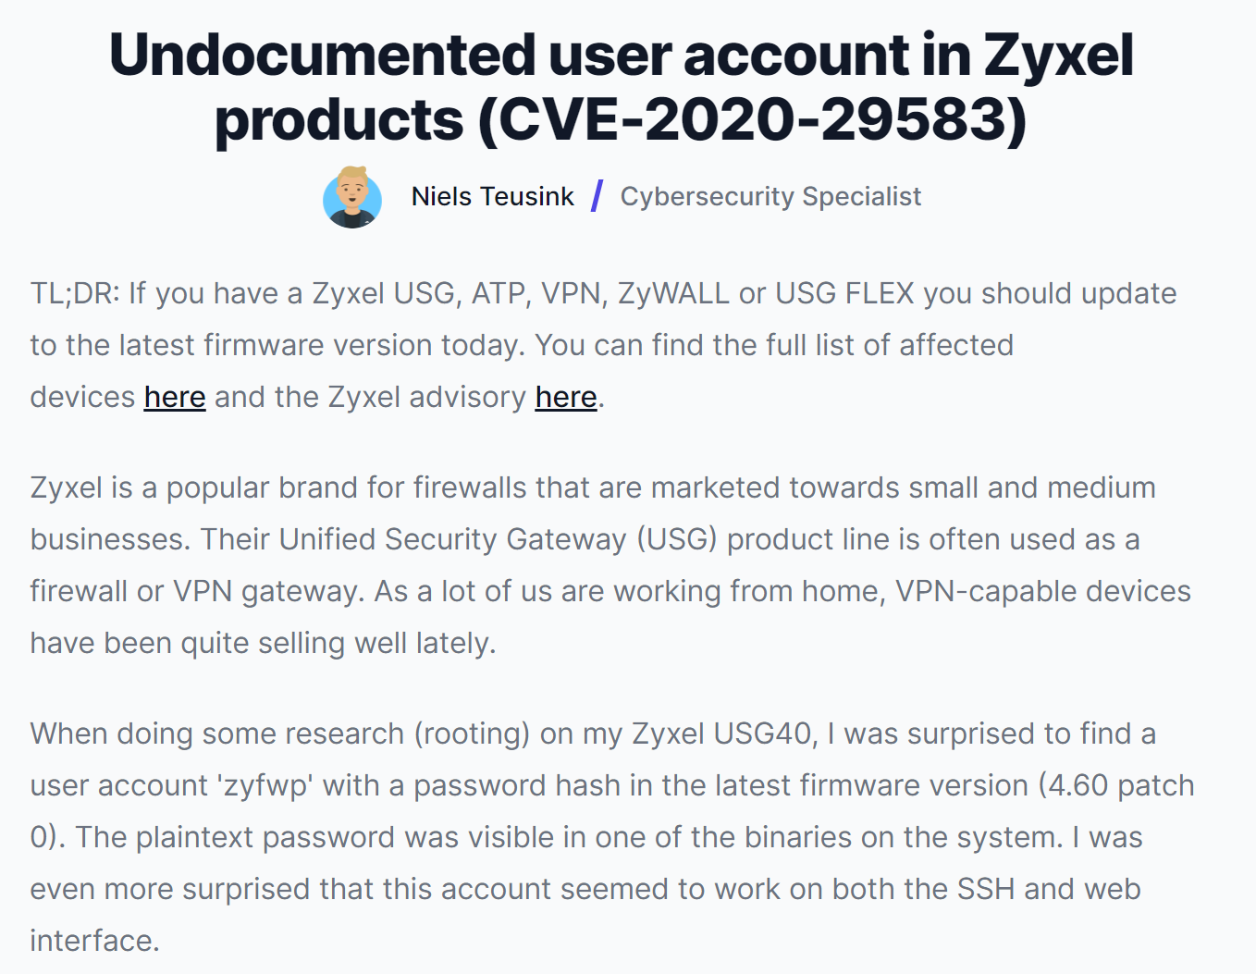
It was December 2020
@jaylagorio // jay@lagor.io
Notes:
https://eye.security/en/blog/undocumented-user-account-in-zyxel-products-cve-2020-29583
So this is all bad, and I’m nosey so I want to see the bug, but even though I’ve thought about it in passing I’ve never gone into the Zywall firmware
This didn't affect me directly because "the account seemed to work on both the SSH and web interface," but I don't expose those to the Internet
But what's to stop someone from getting into the network a different way and turning around to enable more access via my backdoored firewall

Slide 9
It was December 2020
100,000 – 300,000 Potential Devices
@jaylagorio // jay@lagor.io
Notes:
And besides, at the time this affected somewhere between 100k – 300k devices – so let’s dive in.

Slide 10
The Firmware
We’ll just binwalk it and call it a day

Slide 11
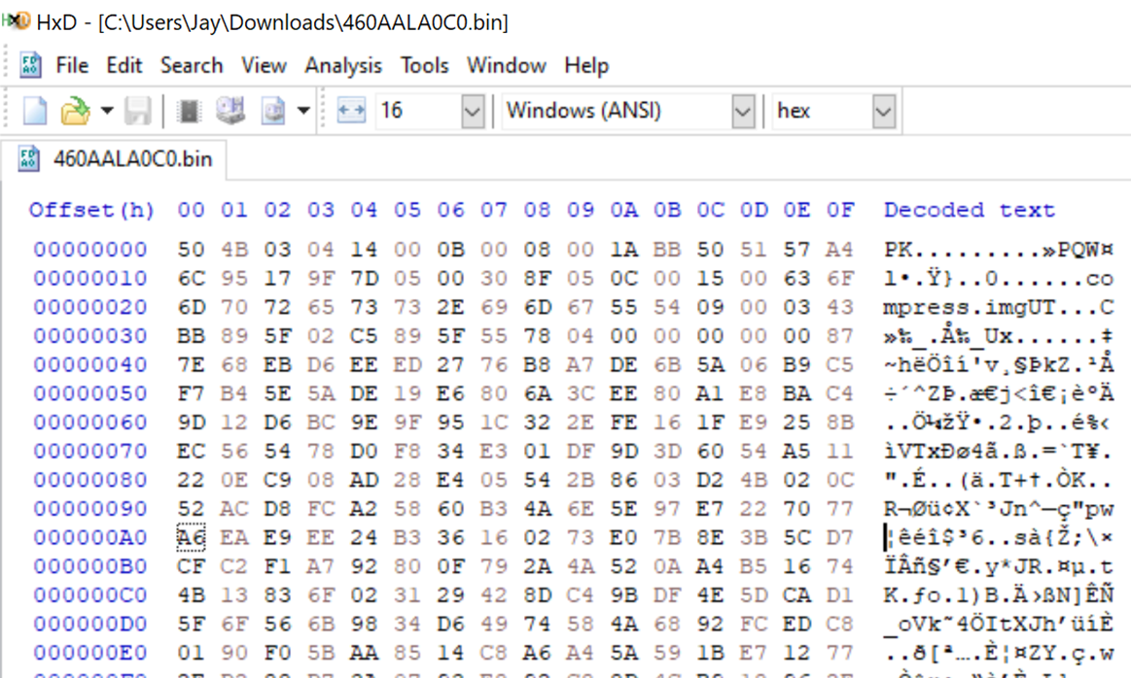
The Firmware
@jaylagorio // jay@lagor.io
Notes:
What do we see?
That PK right there means it’s a zip file
That’s great news! Let’s open it in 7zip

Slide 12
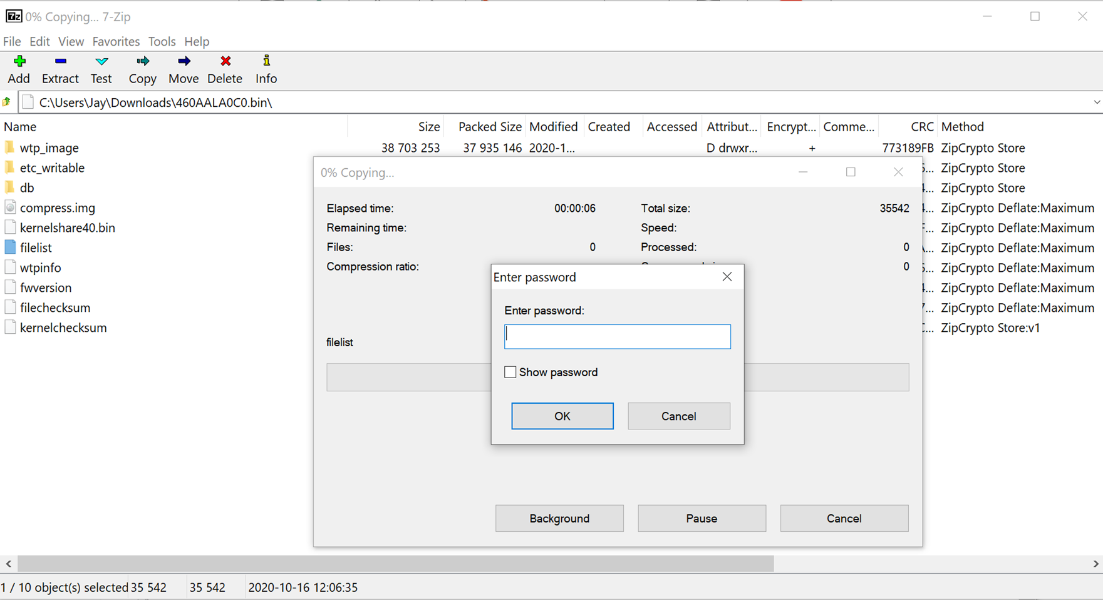
The Firmware
@jaylagorio // jay@lagor.io

Slide 13
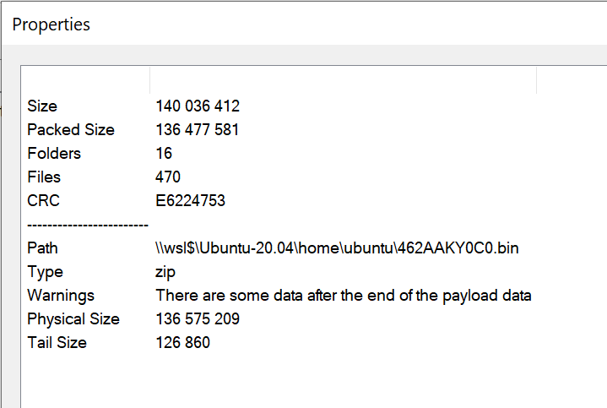
The Firmware
We know it’s a Zip file
The file is password protected
We can see what files are inside
Some files are available online
The update process doesn’t
require a password
7zip says there’s a trailer
@jaylagorio // jay@lagor.io

Slide 14
The Firmware
Default passwords didn’t work
Zip Plain-Text Attack
Attack from 1994
Given a ZipCrypto archive and one file from inside the archive
Derive the keystream for the rest of the archive
Now you have the decrypted archive
@jaylagorio // jay@lagor.io
Notes:
zyxel123
https://github.com/kimci86/bkcrack
So it looks like we need a file from inside the archive

Slide 15
The Firmware
INSERT DIRLIST OF FTP.ZYXEL.COM
@jaylagorio // jay@lagor.io

Slide 16
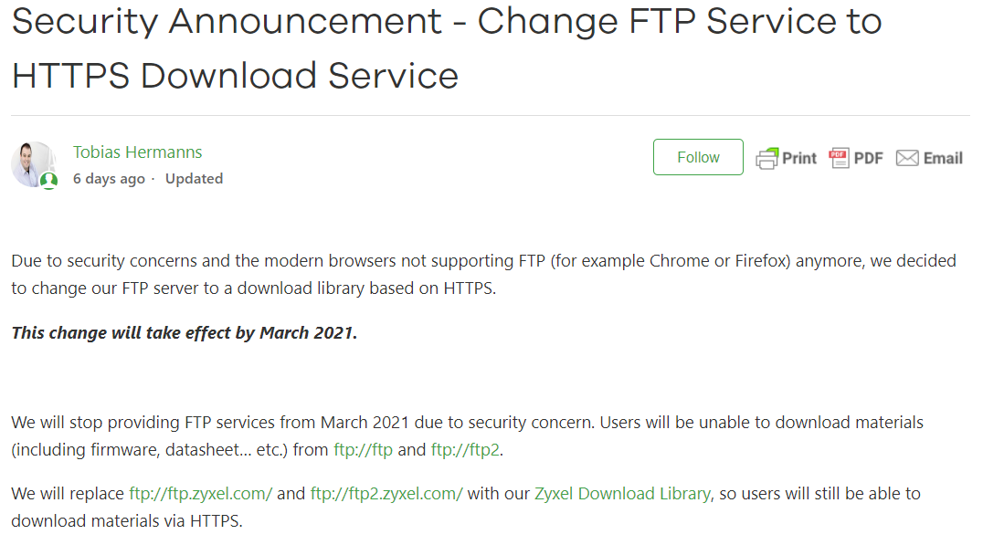
The Firmware
@jaylagorio // jay@lagor.io

Slide 17
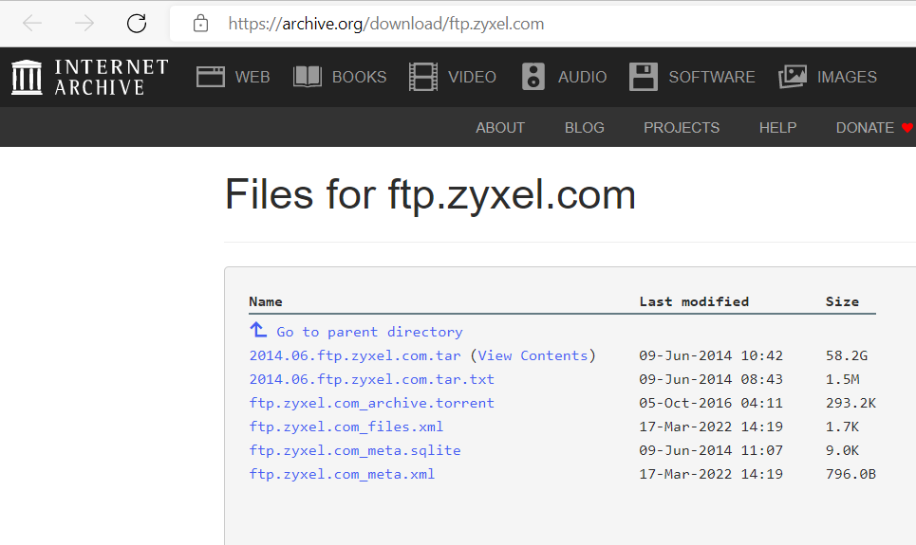
The Firmware
@jaylagorio // jay@lagor.io

Slide 18
The Firmware
Used github:kimci86/bkcrack to run the attack
This didn’t work
Maybe I don’t have the right files?
One more strategy to try
@jaylagorio // jay@lagor.io

Slide 19
The Firmware
Password Cracking
Both LostPassword and JohnTheRipper
Touchy about that trailer, had to strip it
Gave each a couple days while brainstorming
Total failure. Cool.
@jaylagorio // jay@lagor.io
Notes:
And of course it’s our very last resort

Slide 20
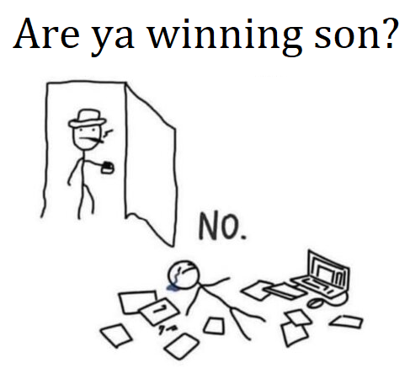
The Firmware
@jaylagorio // jay@lagor.io
Notes:
So this doesn’t feel great, and I realized what I had here was a chicken and egg problem

Slide 21
The Firmware
🐥
🥚
@jaylagorio // jay@lagor.io
Notes:
I’ve got an encrypted firmware and a device that knows how to decrypt it, so somewhere the firmware is decrypted
It just so happens that I’m a hoarder so I have the previous generation of this device on the shelf
So let’s pull it out and put it on a bench

Slide 22
The Hardware
Crackin’ the case

Slide 23
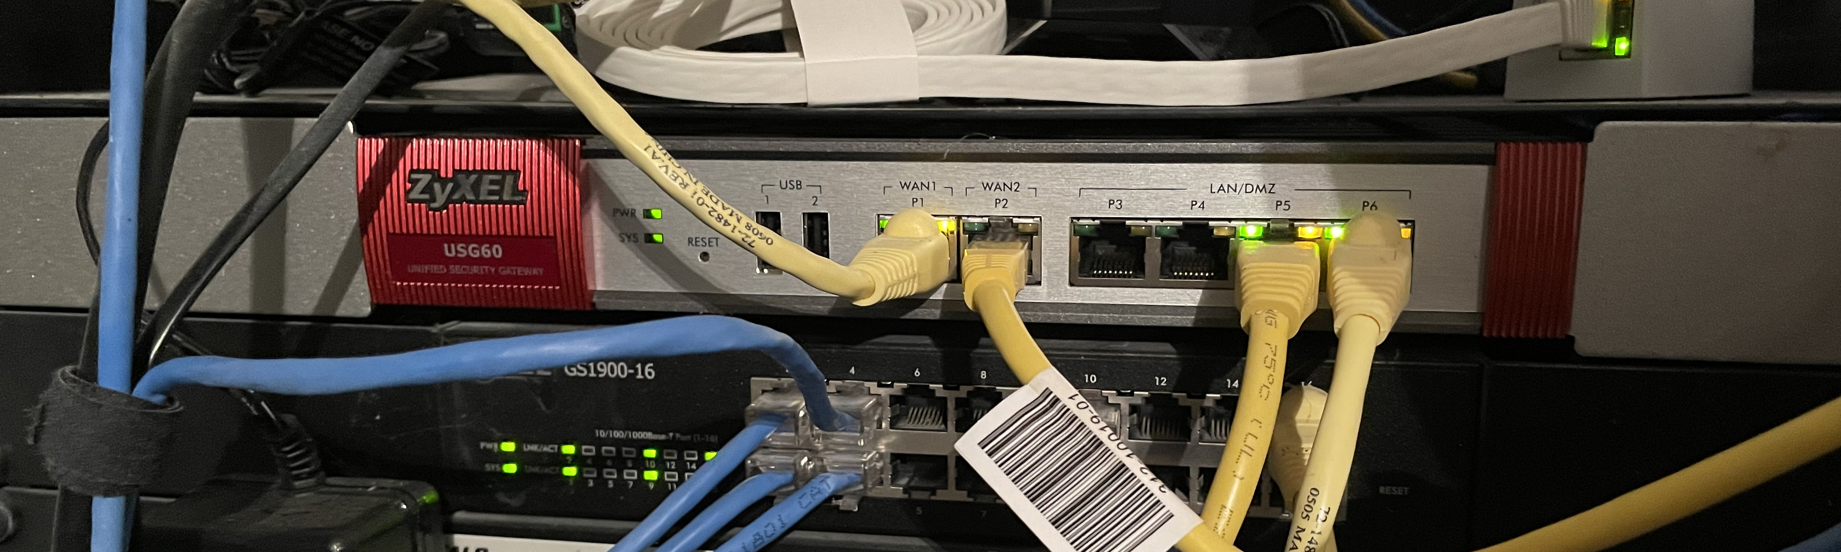
The Hardware
@jaylagorio // jay@lagor.io
Notes:
Here it is in use, definitely not a candidate for /r/cableporn

Slide 24
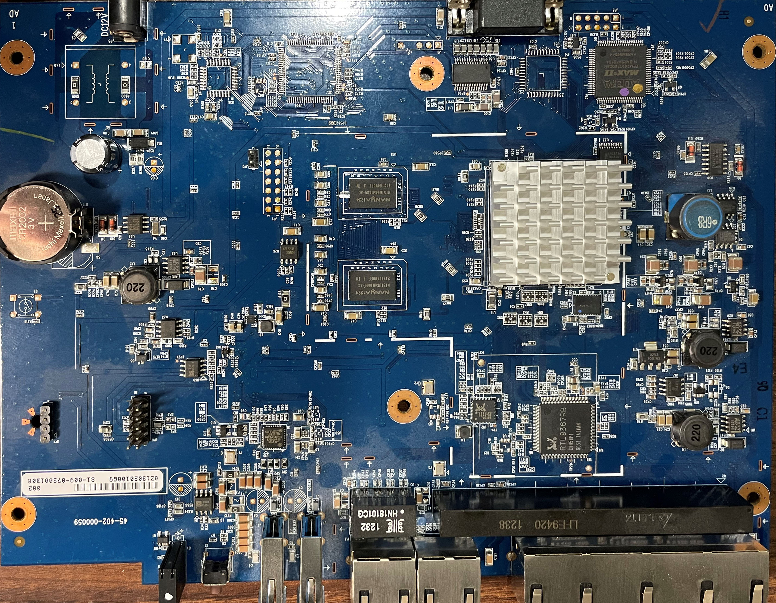
The Hardware
@jaylagorio // jay@lagor.io
Notes:
Here’s the main board, the ports are along the bottom, serial port along the top, just your typical MIPS box

Slide 25
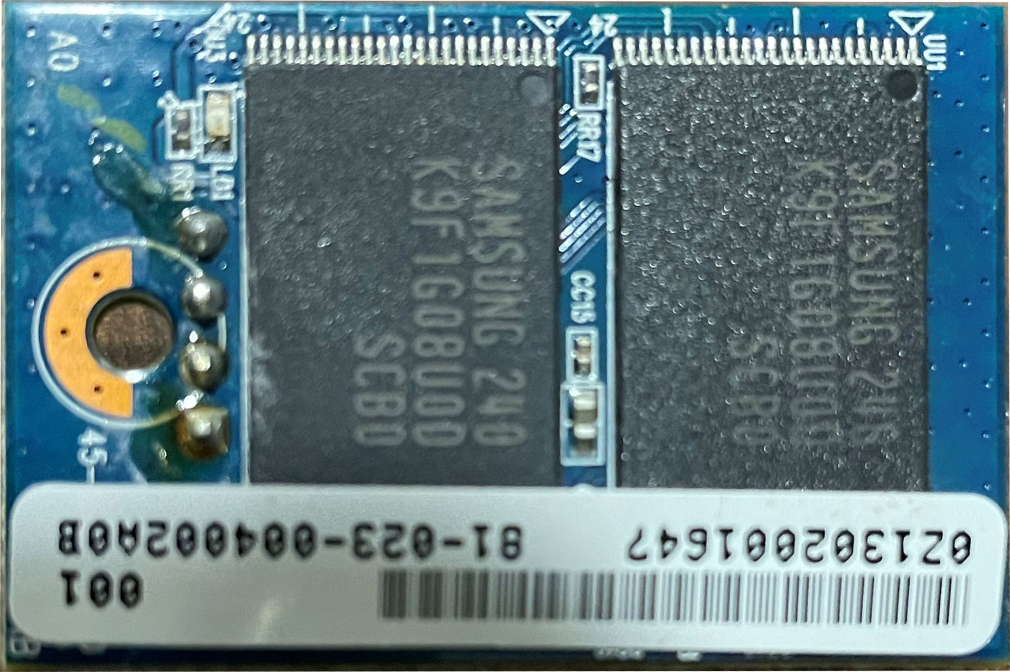
The Hardware
Samsung K9F1G08U0
NAND Flash Chip
@jaylagorio // jay@lagor.io
Notes:
https://www.datasheetarchive.com/K9F1G08U0-datasheet.html
This is the top view, but let’s look under it

Slide 26
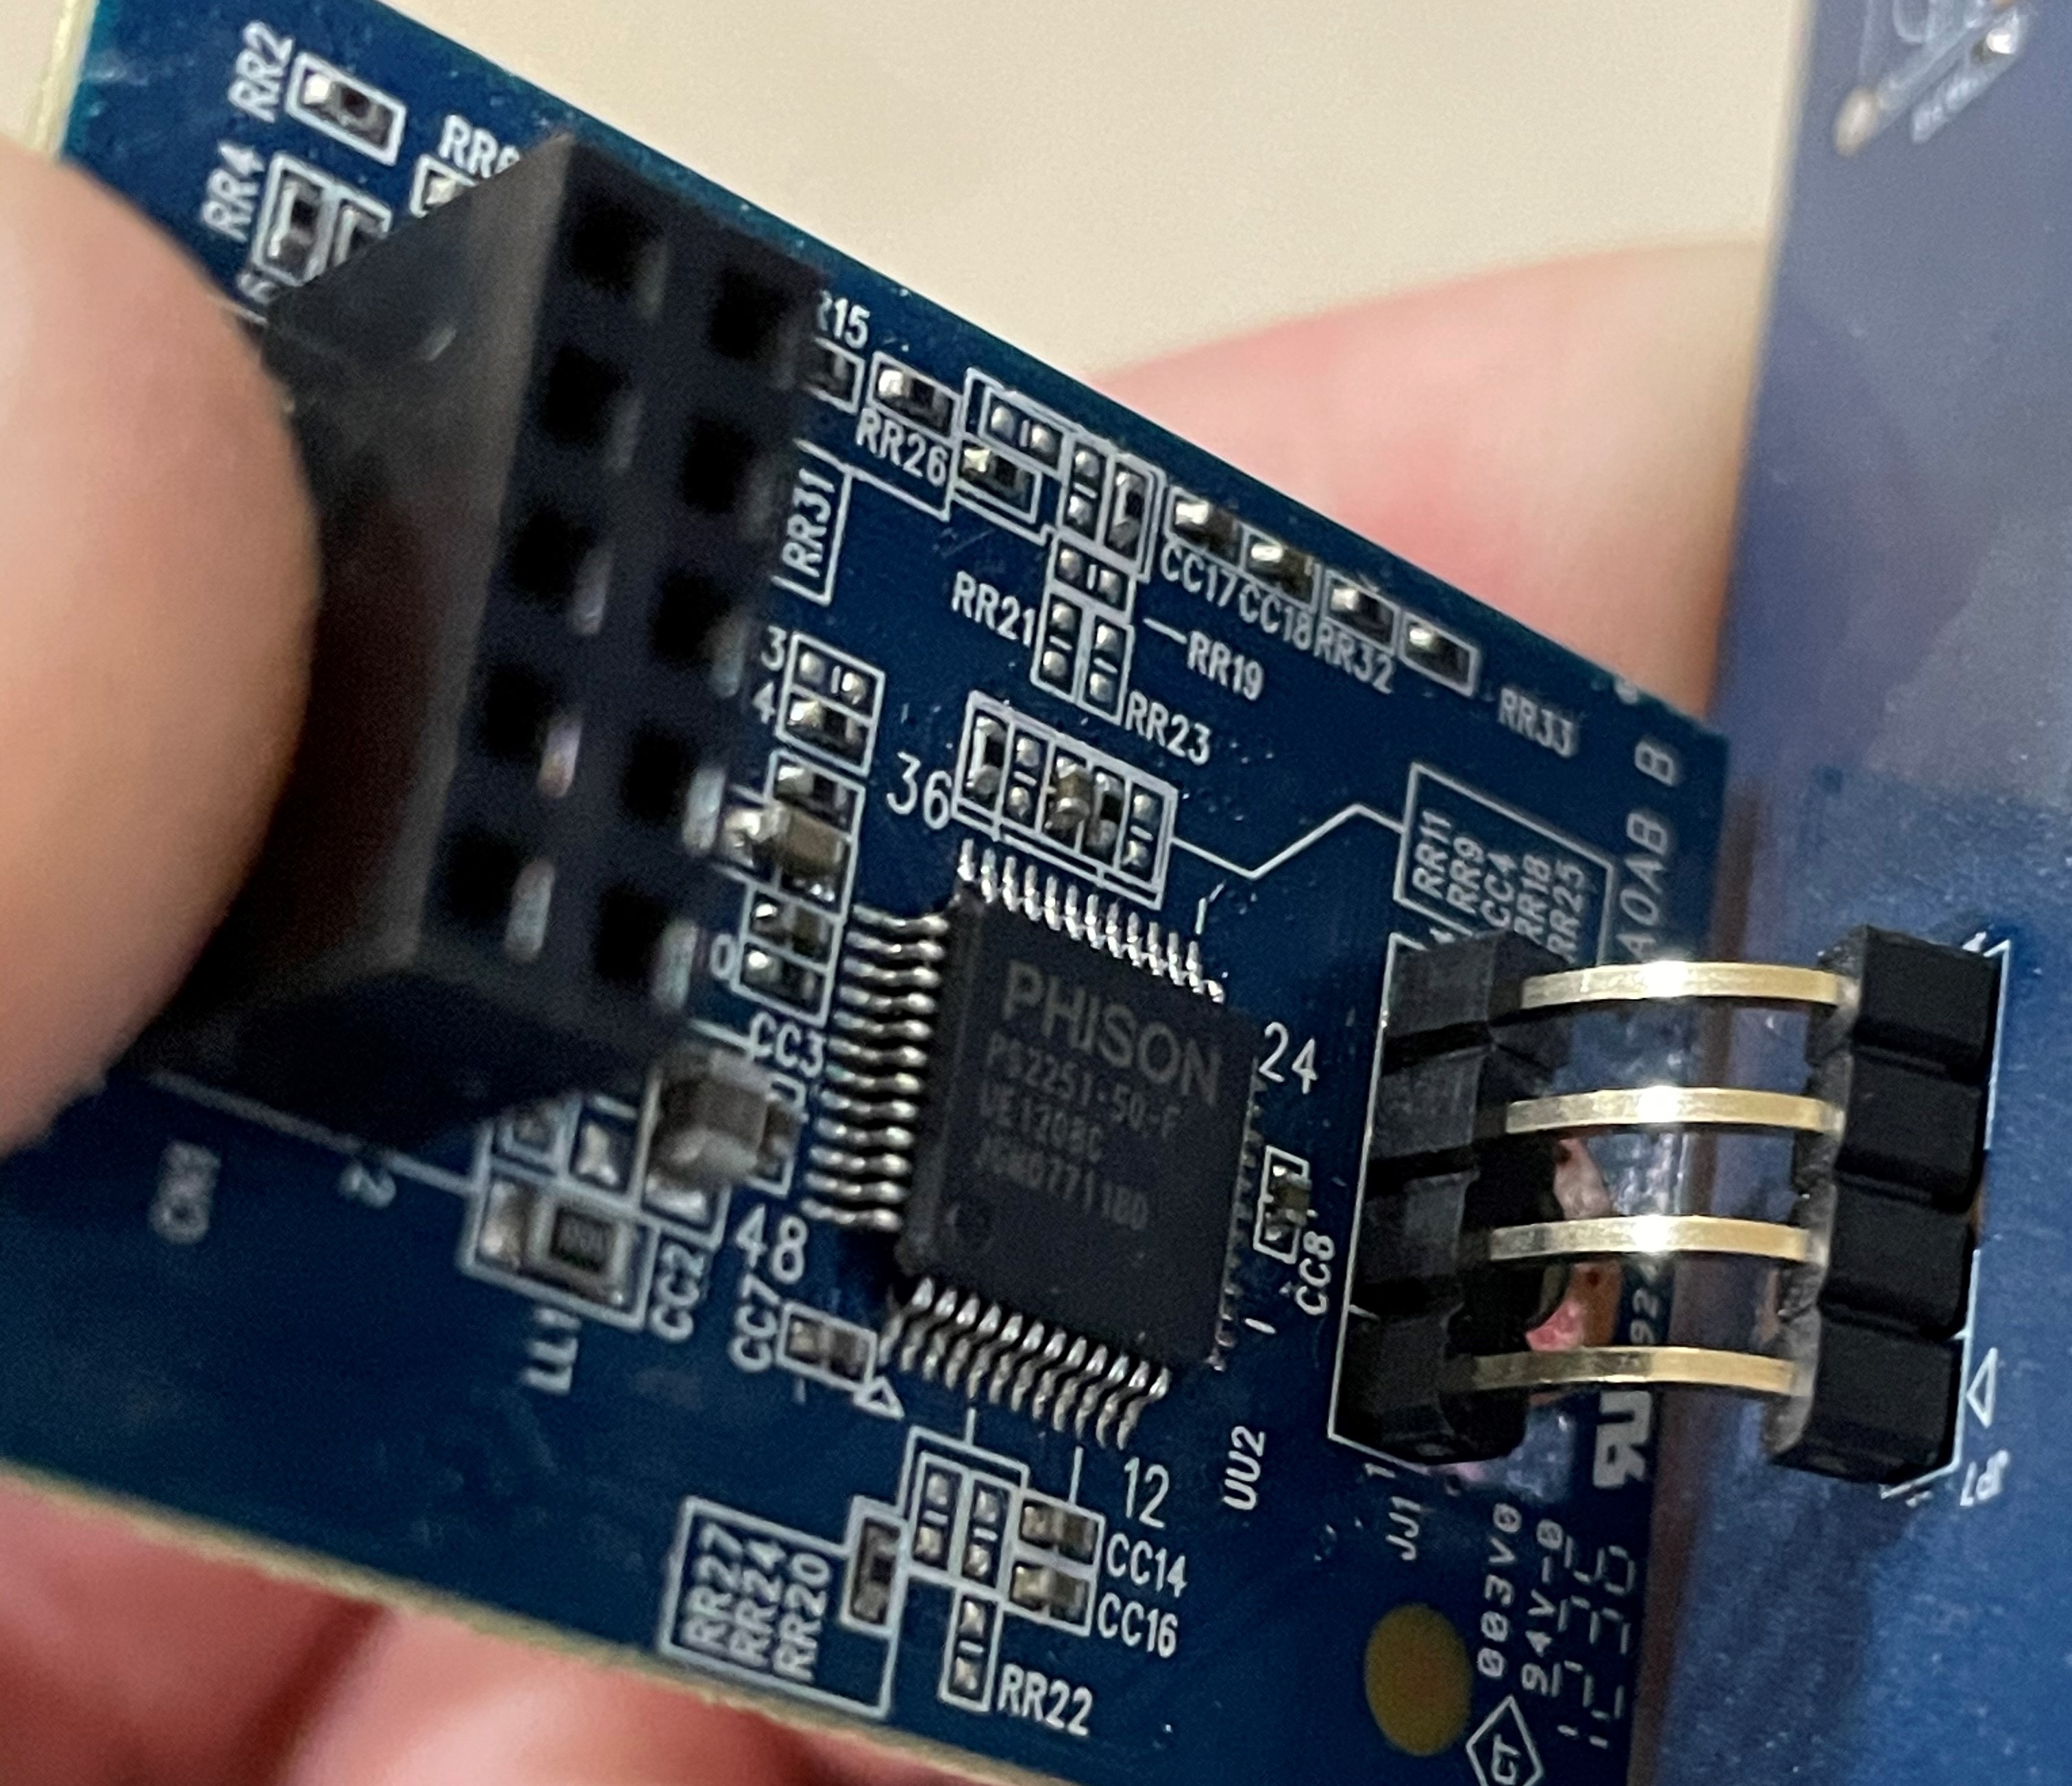
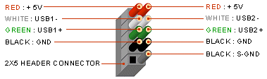
The Hardware
10 pin connector
PHISON PS2251-50-F
???
@jaylagorio // jay@lagor.io
Notes:
https://www.kynix.com/Detail/246017/PS2251-50-F.html
https://frontx.com/cpx108_2.html
It turns out the 10 pin connector is the same thing you’d see on your typical desktop motherboad to connect the external USB ports
The Phison chip is your typical NAND to USB storage chip, you see them on thumb drives all the time

Slide 27
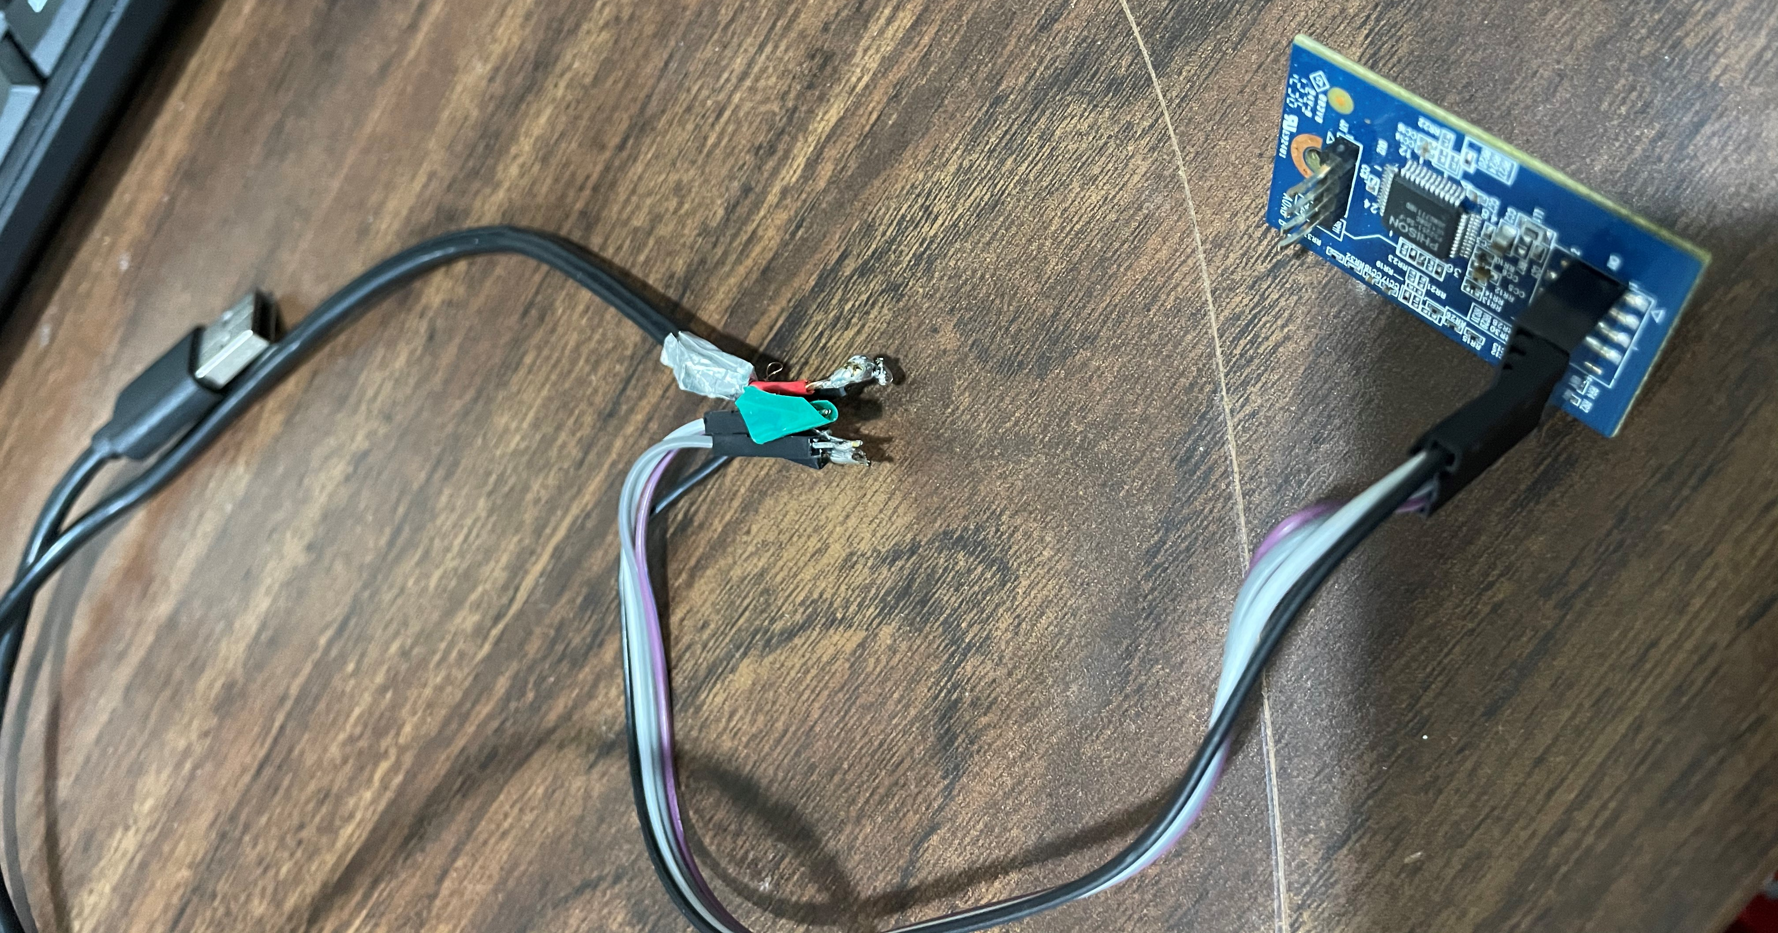
The Hardware
@jaylagorio // jay@lagor.io
Notes:
So we can shove some pins into the USB header and solder them to half of a USB cable

Slide 28
The Hardware
The drive mounts – we have a disk!
Use Win32DiskImager to image the entire drive
Throw the image in BinWalk
And out pops the firmware in plain-text!
…but only the firmware on THIS device.
@jaylagorio // jay@lagor.io
Notes:
https://sourceforge.net/projects/win32diskimager/
https://github.com/ReFirmLabs/binwalk

Slide 29
The Hardware
But decrypting arbitrary firmware files?
@jaylagorio // jay@lagor.io
Notes:
Well, now we have a starting point!

Slide 30
The Software
Decompilers are free now!

Slide 31
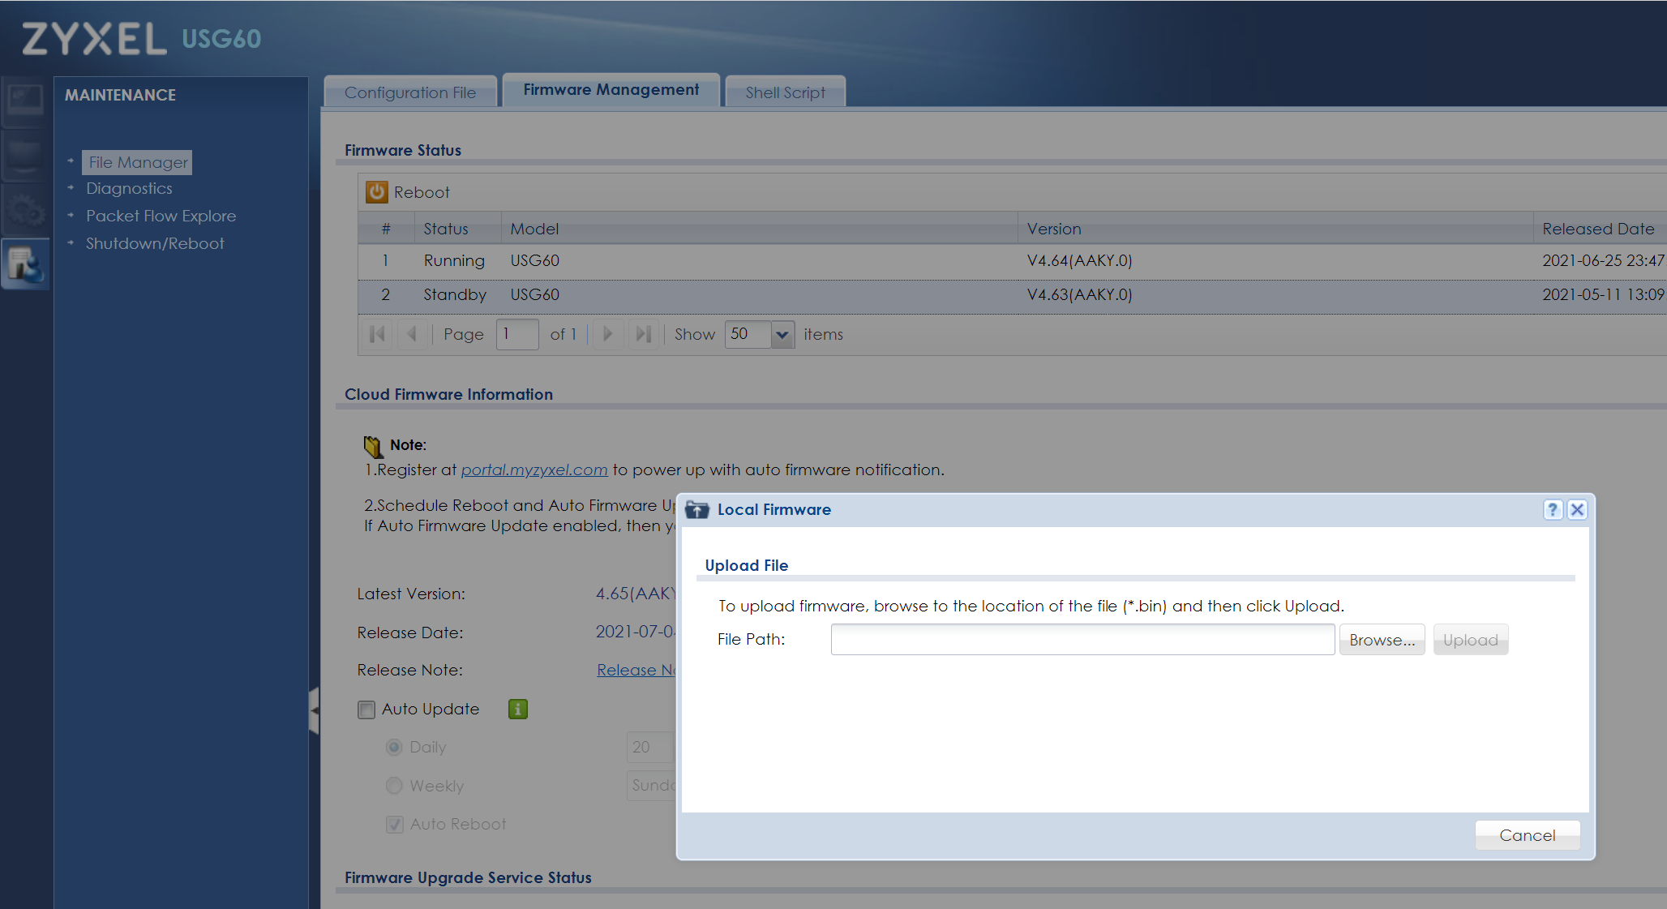
The Software
@jaylagorio // jay@lagor.io

Slide 32
The Software
Device runs an Apache web server
Submits to firmware_upload-cgi in cgi-bin
Contains string /util/zld_fsextract
File System Extract?
Let’s Google it
@jaylagorio // jay@lagor.io
Notes:
…so we’ll look for the static page
…so we’ll run strings
Throw that file name into Google and get one result

Slide 33
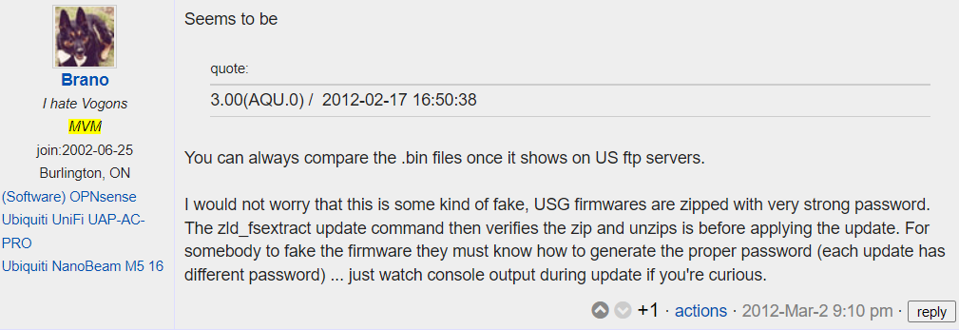
The Software
@jaylagorio // jay@lagor.io
Notes:
https://www.dslreports.com/forum/remark,26961186
Just one single solitary result

Slide 34
The Software
The binary’s from a previous model though…
Same processor architecture
Firmware formats appear the same
If it ain’t broke, why fix it?
Spoiler: the newer models have the same binary so we made a smart bet
@jaylagorio // jay@lagor.io
Notes:
Devices have the same processor architecture
Firmware formats: encrypted zip, trailing bytes
There’s no information whatsoever on the Internet as to how to decrypt these files – from the vendor perspective it ain’t broke

Slide 35
The Software
Run file
ELF 32-bit MSB executable, MIPS, N32 MIPS64 rel2 version 1 (SYSV), statically linked, stripped
Run strings
usage: %s <input zip file> {-t | <unzip path> {-s <SET_EXTRACTION_COMMAND> | [-f file1 [-f file2 ...] ] [-d dir1 [-d dir2 ...] ] [-i]} [-D destDir]}
7za
@jaylagorio // jay@lagor.io

Slide 36

The Software
@jaylagorio // jay@lagor.io
Notes:
If you’ve been living under a rock, this is a free disassembler and decompiler by the National Security Agency

Slide 37
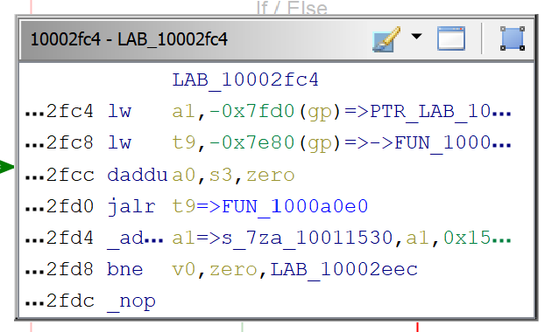
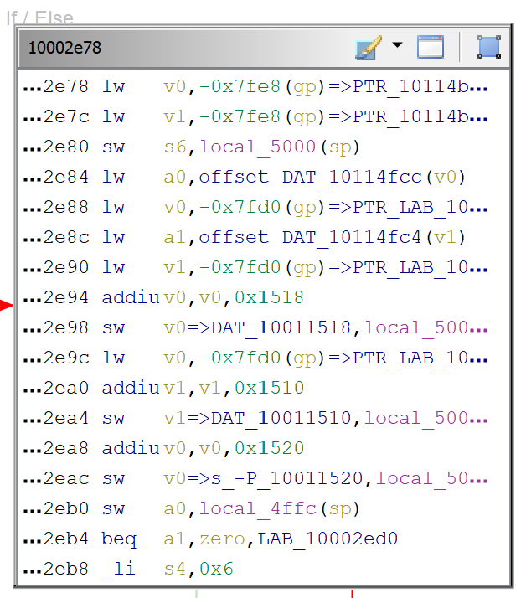
The Software
@jaylagorio // jay@lagor.io

Slide 38
The Software
Qemu Usermode Emulation for MIPS to run it
sudo cp ld-2.3.3.so /lib/
sudo ln /lib/ld-2.3.3.so /lib/ld.so.1
Run it with strace to find calls out to 7za
qemu-mipsn32 -strace zld_fsextract 460AAKY1C0.bin -i &2>1 > out.txt
@jaylagorio // jay@lagor.io

Slide 39
The Software
23402 open("460AAKY1C0.bin",O_RDONLY) = 3
23402 ioctl(3,21517,1082130192,0,1082130828,0) = -1 errno=25 (Inappropriate ioctl for device)
23402 brk(0x10136000) = 0x10136000
23402 lseek(3,-12,2,269700176,1082130828,1) = 136687321
23402 Linux(3,1082130448,4,269700112,1082130828,1) = 4
23402 Linux(3,1082130452,4,269700112,1082130828,1) = 4
23402 brk(0x10155000) = 0x10155000
23402 lseek(3,-126860,2,269704280,1082130828,1) = 136560473
23402 Linux(3,269704288,126848,269700112,1082130828,1) = 126848
@jaylagorio // jay@lagor.io
Notes:
Right off the bat we open the file for read and seek to 124K from the end of the file
Now I’m not saying I don’t believe in coincidences, but this should look familiar

Slide 40
The Software
qemu-mipsn32 -strace zld_fsextract 460AAKY1C0.bin -i &2>1 > out.txt
23408 execve("-i",{"-i","-o","-q","-P", "iRqoEoQpAdoiQmOlW9ksF4XgFhOiyehh6YVMMxCYa0G0ohnKsXC8emqvTFdRvL8",
"460AAKY1C0.bin","db/etc/",NULL}) =
-1 errno=2 (No such file or directory)
@jaylagorio // jay@lagor.io
Notes:
We could plug a tool in here that could spit out the password because we have direct control of that parameter
I didn’t tell the conference reviewers that I was going to release a tool today, so I’m going to put it on the screen and it’ll be our little secret

Slide 41
The Software
// printarg4.c
#include <stdio.h>
int main(int argc, char* argv[])
{
printf("%s\n", argv[4]);
return 0;
}
@jaylagorio // jay@lagor.io
Notes:
This is the most complicated tool I’ve ever released
No stop, please don’t take any pictures, it’s super proprietary

Slide 42
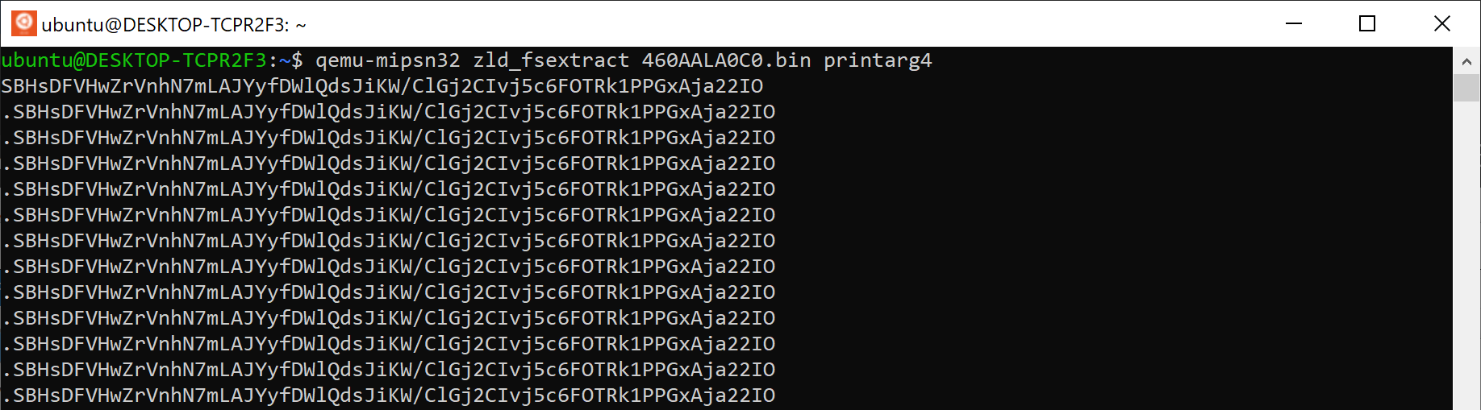
The Software
@jaylagorio // jay@lagor.io
Notes:
You can feed the extractor any firmware file and it quickly outputs the password for easy extraction with 7zip. Success!

Slide 43
How It’s Going
We fucked around, now let’s find out!
Notes:
So can we see the bug yet?

Slide 44
The Bug
It turns out my backup of the firmware got corrupted.
Are you testing your backup strategy?
No? Then do you actually have one?
This version of the firmware is completely gone.
What to do?
I extracted it like this, and since we already know the IOCs we can grep for them.
@jaylagorio // jay@lagor.io
Notes:
Zyxel effectively memory-holed these backdoored firmware versions from the Internet. They’re just gone.
So I DMed the researcher, Neils Teusink on Twitter! He sent his copy for the USG40 over

Slide 45
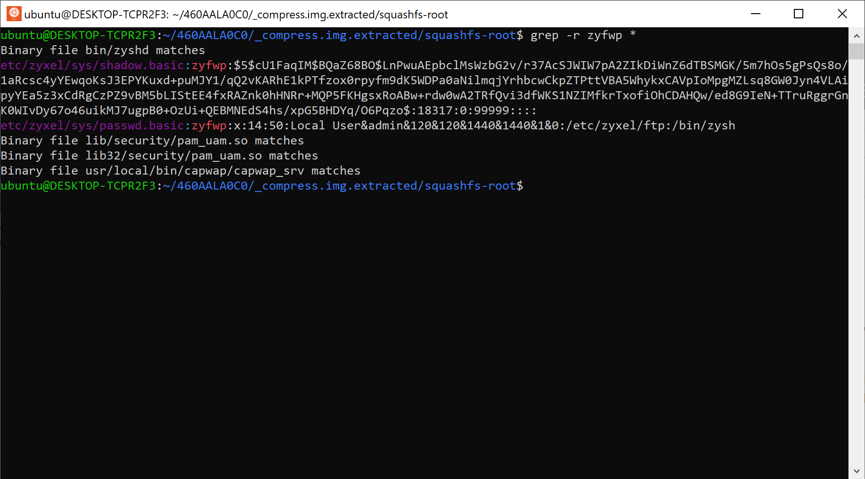
The Bug
@jaylagorio // jay@lagor.io

Slide 46
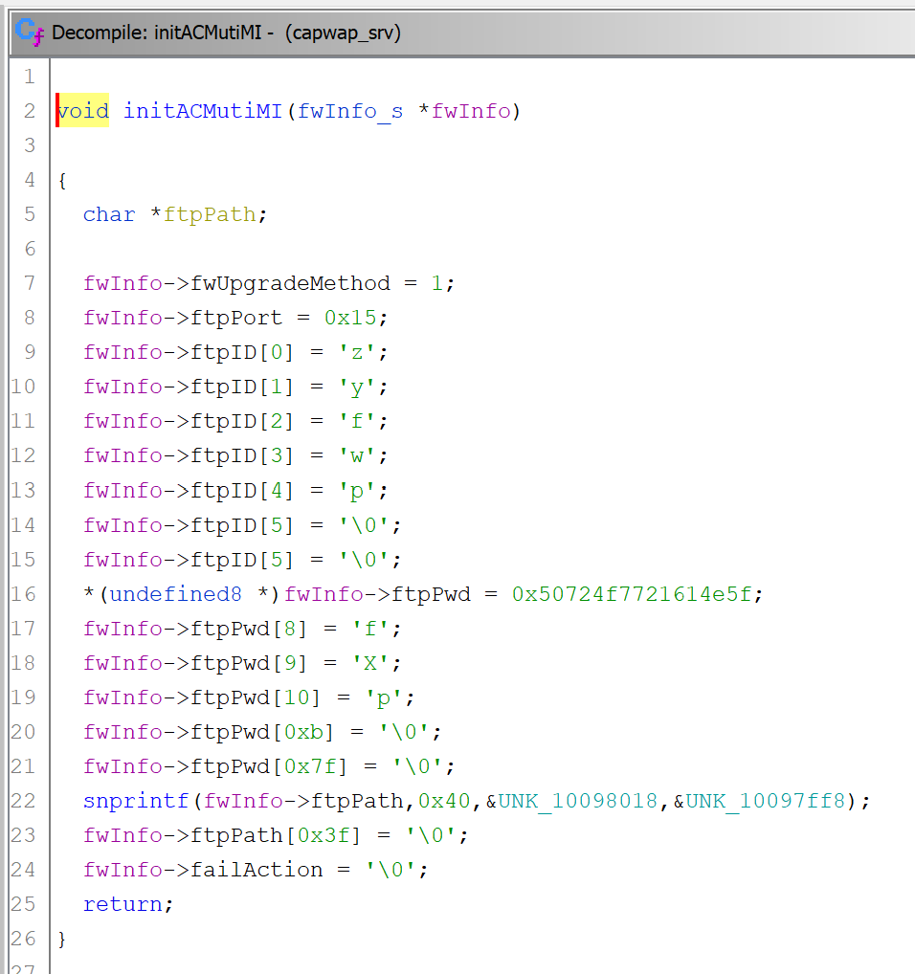
The Bug
@jaylagorio // jay@lagor.io

Slide 47
Future Work
Stuff I’m never going to have time for

Slide 48
The Future
Make a Python script
The deobfuscation function is at 0x10009F00 and is called from what calls 7za at 0x10002DE0
@jaylagorio // jay@lagor.io
Notes:
Turn the deobfuscation algorithm into a Python script so you can just point it at a firmware file and get the password
And I hope someone does this because it’d be so much better than the Rubegoldberg’s machine I have going on here
But I also mentioned I’m not releasing a tool, and fsextract sure sounds like one, so how are you going to do that?

Slide 49
The Future
It turns out all this was way easier than I made it
Firmware updates include the firmware, some release notes, a .ri file for recovery
It’s unencrypted, you can binwalk it directly, and it contains zld_fsextract
Thanks to HN Security for pointing out what should have been obvious
@jaylagorio // jay@lagor.io
Notes:
https://security.humanativaspa.it/zyxel-firmware-extraction-and-password-analysis/
If you Google HN Security zyxel firmware they actually have a series of Zyxel articles published this year, they’re good reads
And if you go that route no firewalls need to be harmed in the process of your research

Slide 50
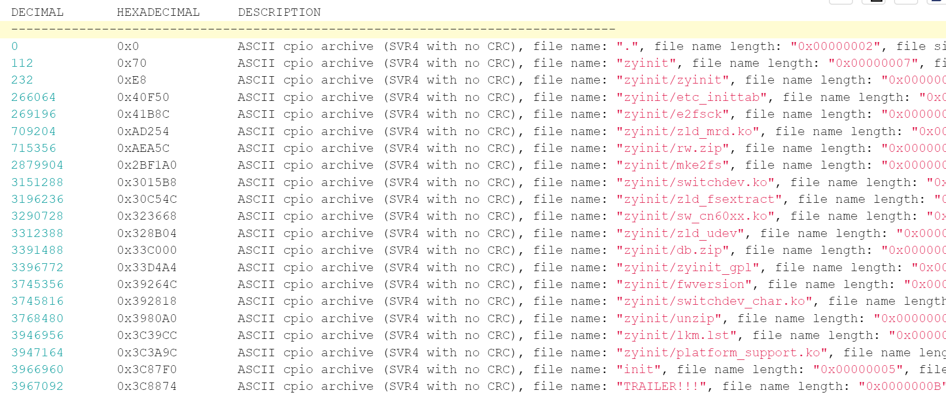
The Future
@jaylagorio // jay@lagor.io
Notes:
Here’s their screenshot of the binwalk of the .ri file, it’s right there
So we thank our firewalls for their sacrifice and protecting me from just looking at what was literally right there

Slide 51
The Future
Make a Python script
The deobfuscation function is at 0x10009F00 and is called from what calls 7za at 0x10002DE0
Run the decrypted firmware through EMBA
compress.img is your friend
@jaylagorio // jay@lagor.io
Notes:
EMBA’s a really great firmware analysis tool that’s still pretty new

Slide 52
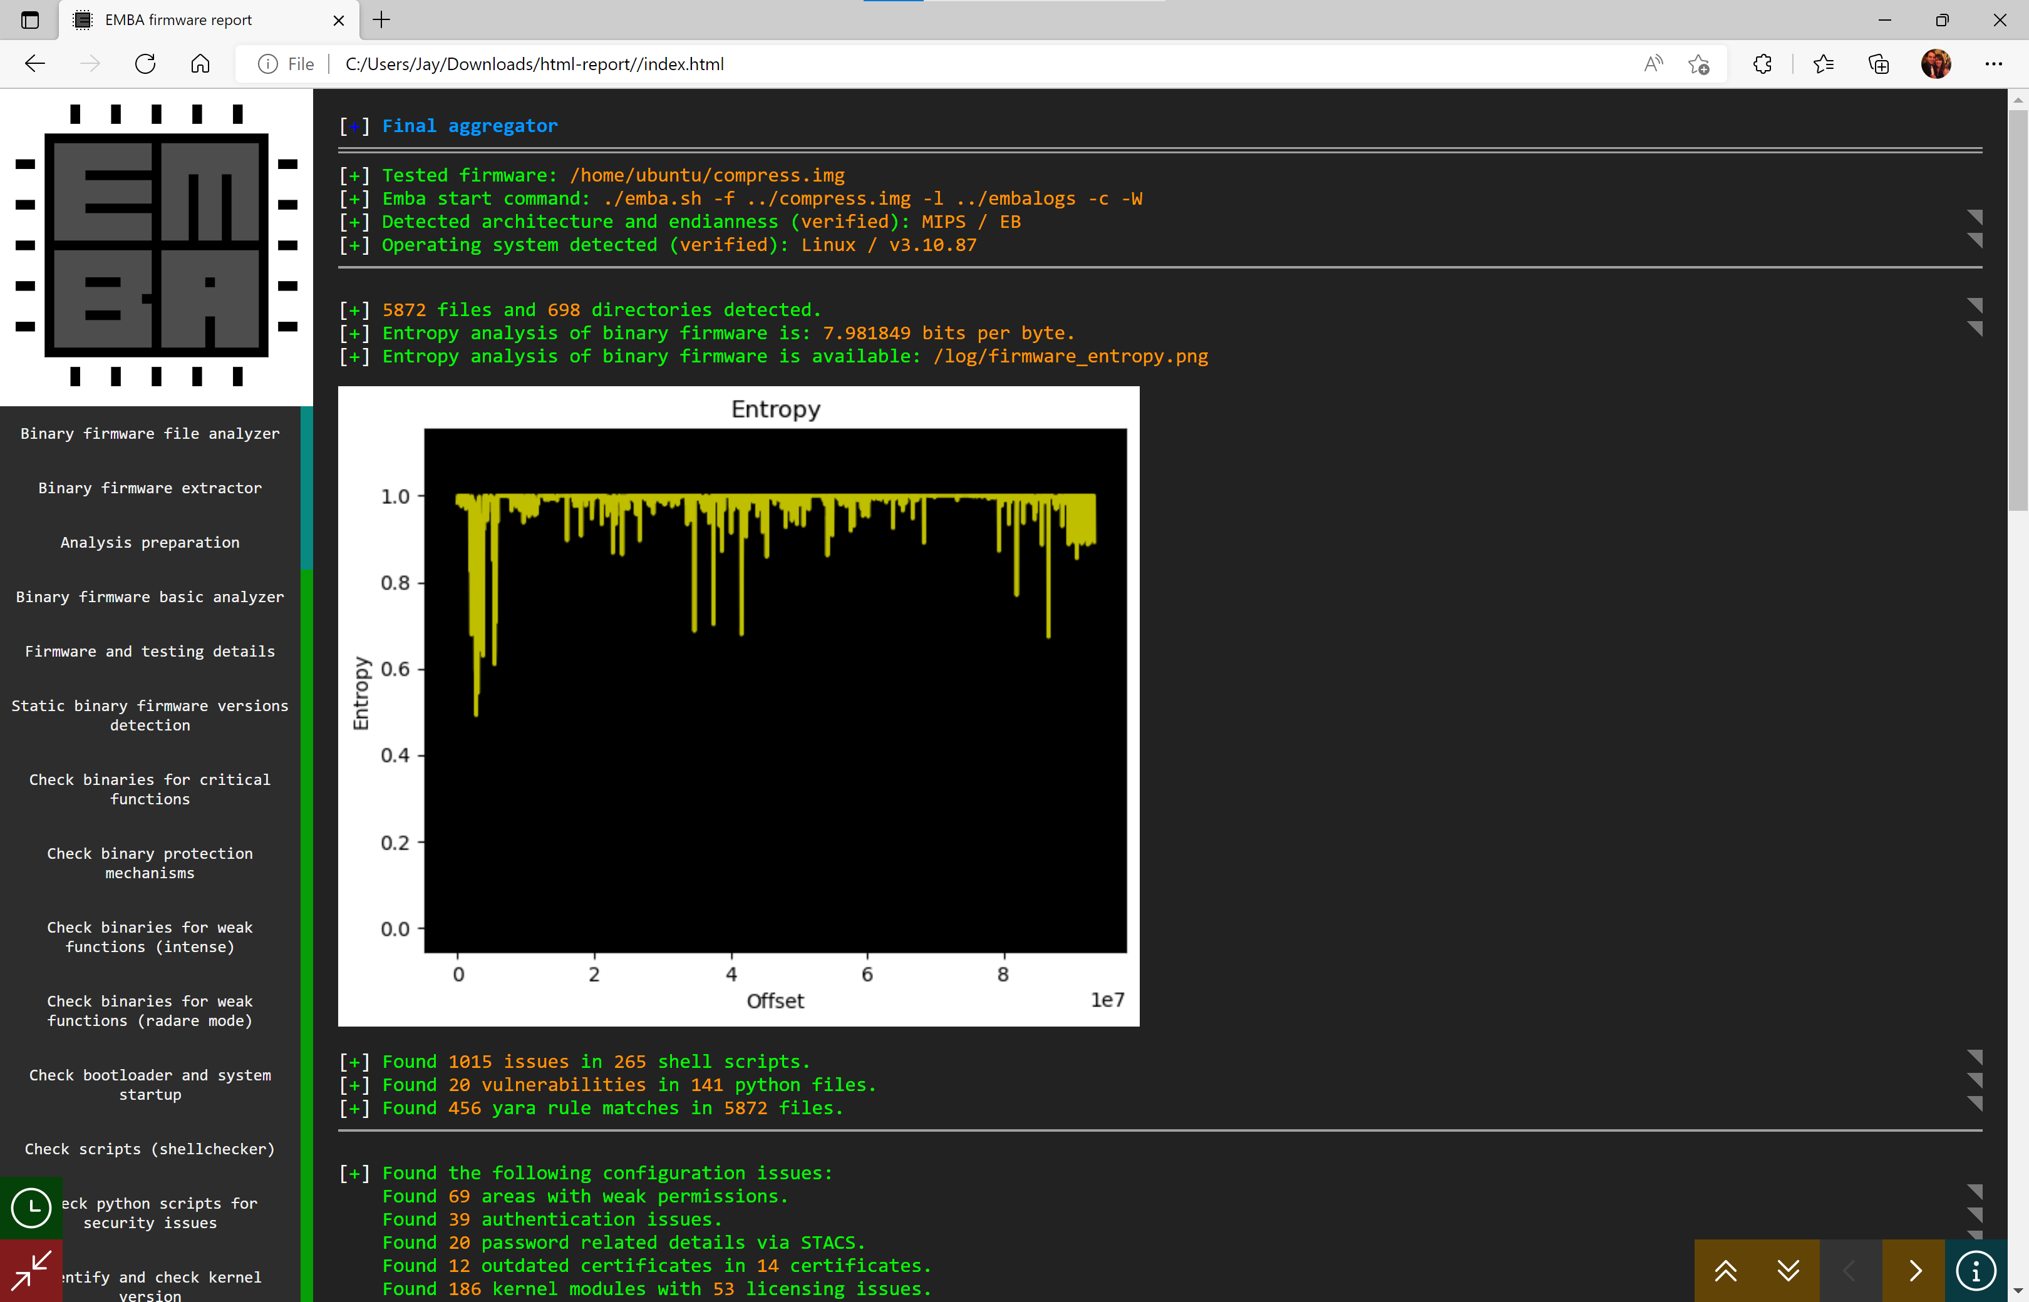
The Future
@jaylagorio // jay@lagor.io
Notes:
It generates a slick report at the end that shows everything it found and boy can it find a lot.
Started out as a text output-only tool, but it’s recently gotten a really sweet web-based output that you can browse locally
From our process above, it can do everything after the unzip process including automated binwalk, check against known CVEs, and even emulation of the target binaries for the whole spectrum of static and dynamic analysis

Slide 53
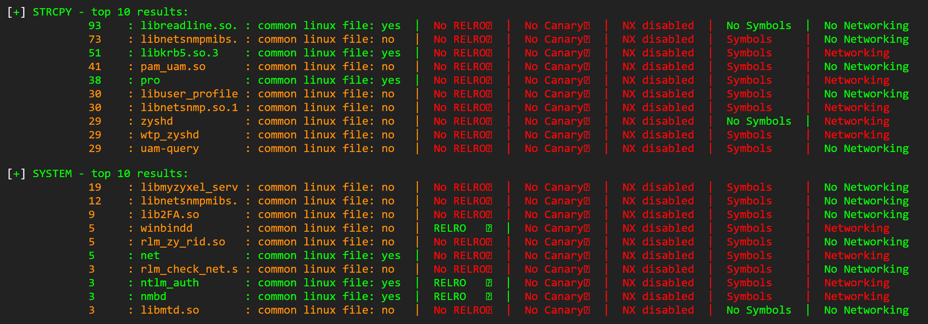
The Future
@jaylagorio // jay@lagor.io
Notes:
The only thing I love more than strcpy is memcpy, and the only thing I love more than that is a binary that calls System with one or both of those two in it

Slide 54
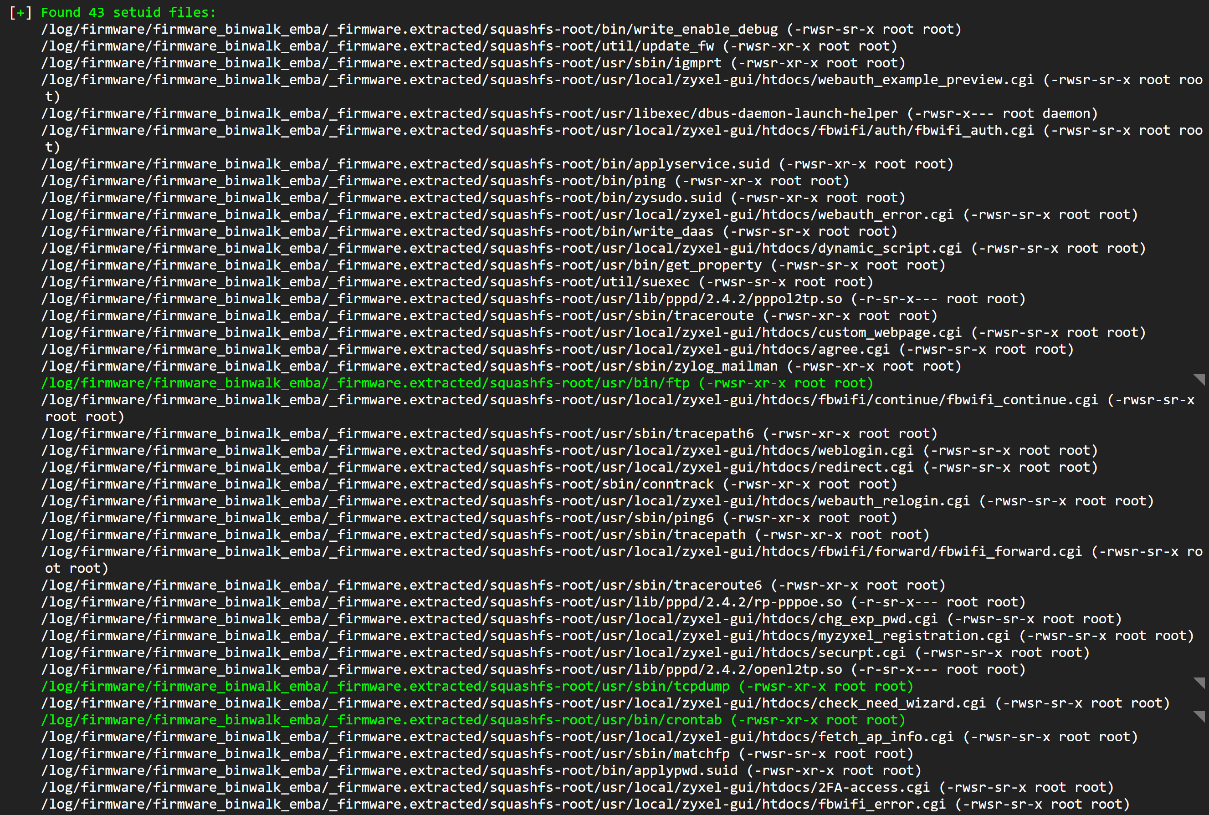
The Future
@jaylagorio // jay@lagor.io
Notes:
I see a lot of files that can SUID to whatever, and while some make sense others definitely do not

Slide 55
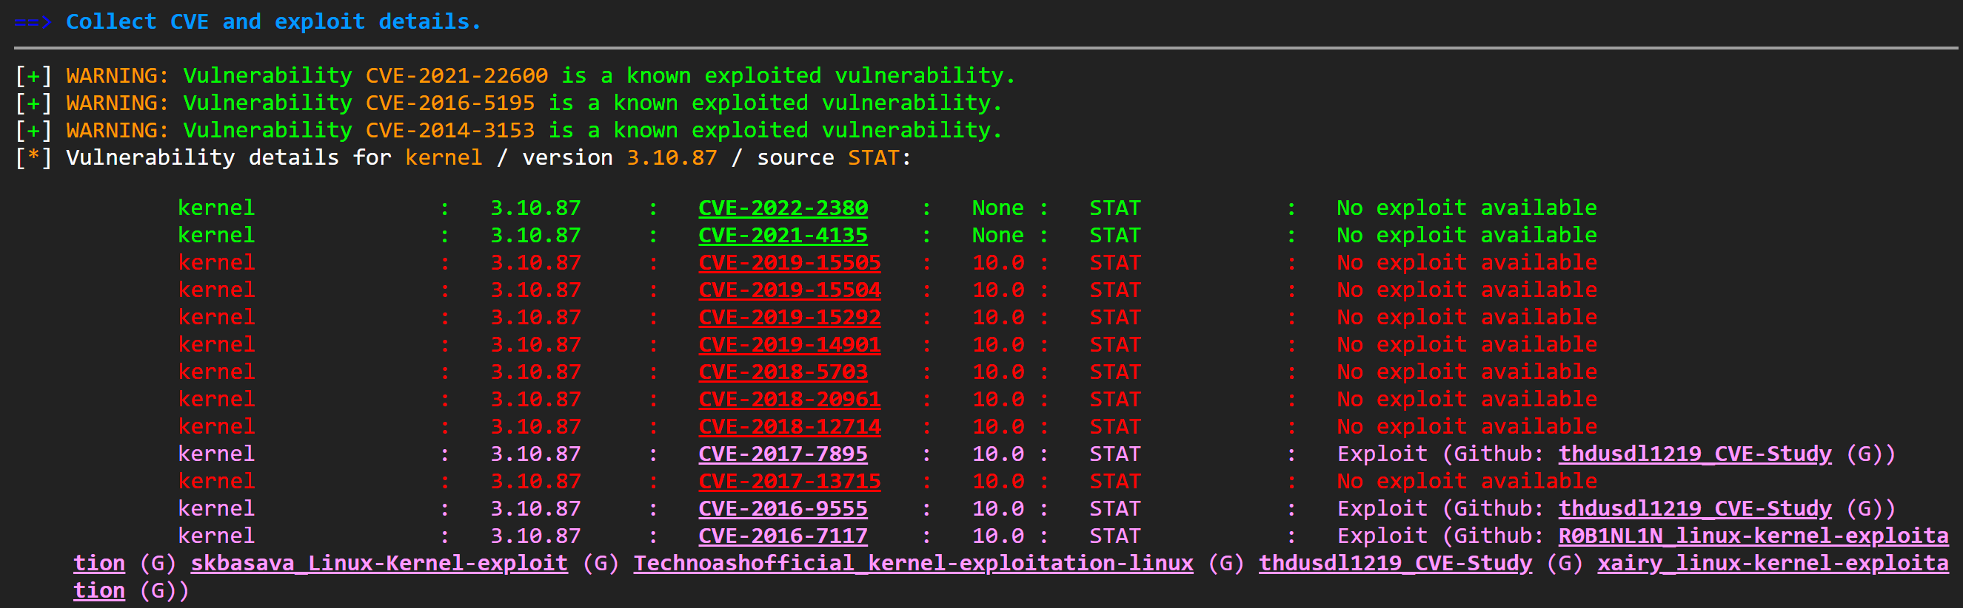
The Future
@jaylagorio // jay@lagor.io

Slide 56
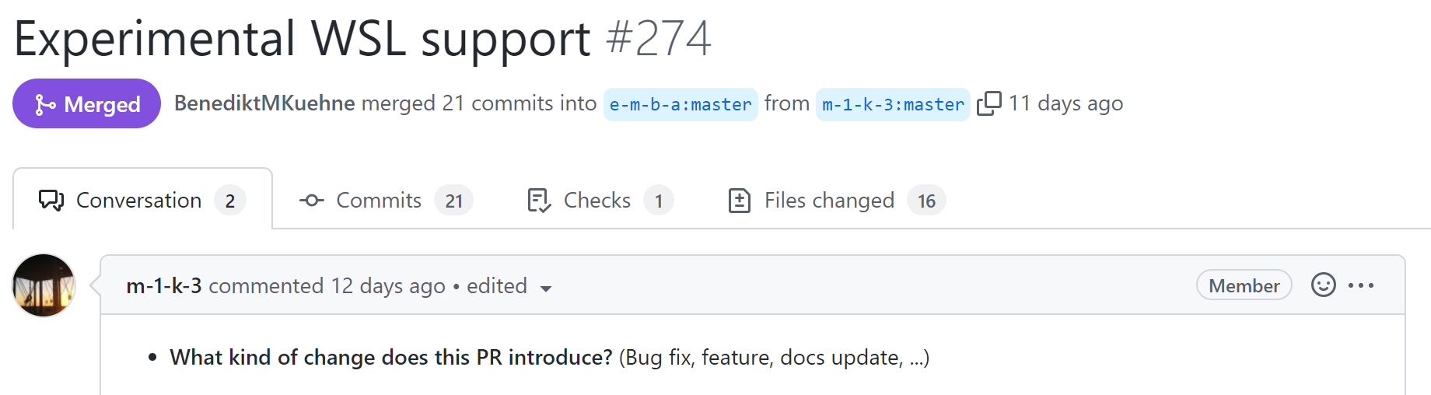
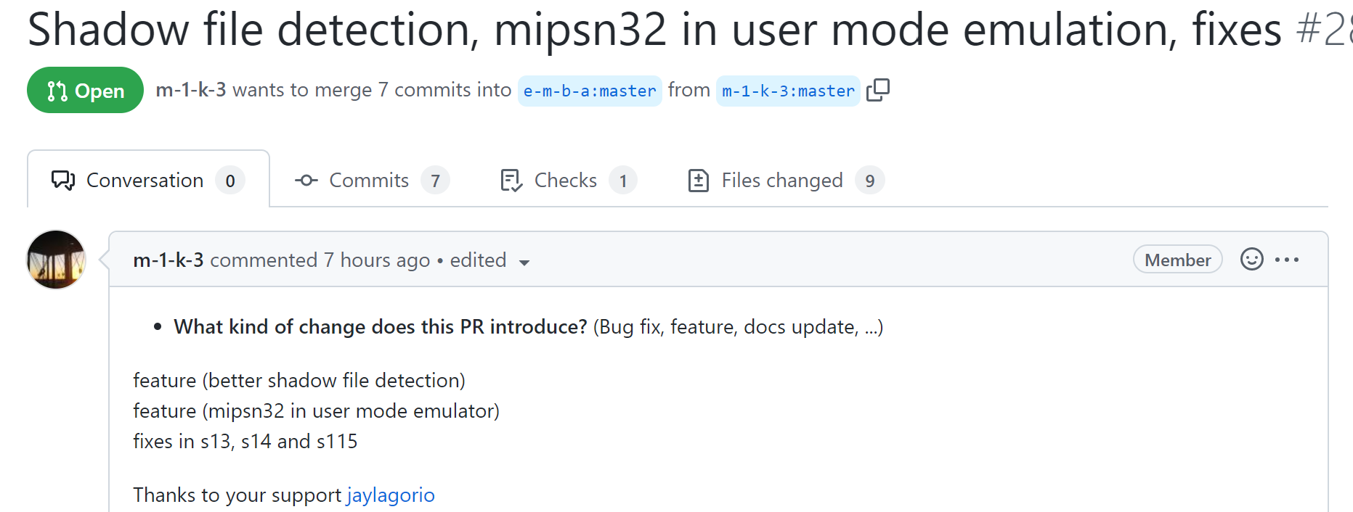
The Future
@jaylagorio // jay@lagor.io
Notes:
It turns out EMBA on WSL might not be a long way off because I was working with the developer Michael Messner on how this can be done
The later version of EMBA have a dependency on Docker and WSL on Windows 10 has some manner of incompatibility, so the immediate answer was to load up an Ubuntu VM on Win 10, but that’s a heavier lift than maybe it should be.
And they added some improvements based on the decrypted usermode image that they wouldn’t have otherwise had access to

Slide 57
The Future
Make a Python script
The deobfuscation function is at 0x10009F00 and is called from what calls 7za at 0x10002DE0
Run the decrypted firmware through EMBA
compress.img is your friend
Track whether and when Zyxel makes a breaking change to this process
@jaylagorio // jay@lagor.io
Notes:
And the last thing I’d pay attention to is when Zyxel starts changing things

Slide 58
The Future
Plain-Text
Transition
Encrypted
@jaylagorio // jay@lagor.io
Notes:
I loved this diagram in a prior talk but I couldn't find it again so if you know who made it tag me on Twitter so I can cite them. Because in theory we're over here on the left where we can get the plaintext version of the format, and then there will be a transition, and then it'll be encrypted again and we won't be able to see anything
But to get here in the middle the firmware they publish that will understand the format changes going forward will itself be vulnerable to this process
And there will be dead-giveaway language to indicate which version has the new stuff
“you have to install version X before you can install version Y and beyond” in future updates because firmware before version X won’t know how to handle the new update mechanism introduced in version Y. It won’t conform to the old scheme.
Once you trace the upgrade flow in that intermediary version you’ll know how to decrypt the new protection scheme. I leave that as a fun extercise for the listener.

Slide 59
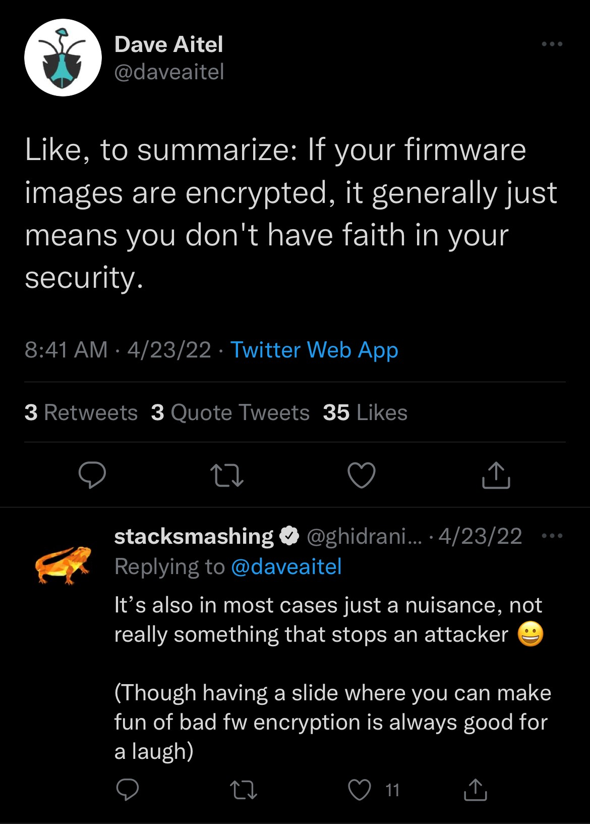
The Future
@jaylagorio // jay@lagor.io
Notes:
This went by as I was making these slides and I think stacksmashing is presenting this year, but I thought it good to point out. I guess I’ve seen some bad firmware air-quotes encryption like static XORs or rolling XORs or what have you, and this wasn’t the worst but man if you’re shipping backdoor accounts maybe Dave’s not wrong and you do need it.

Slide 60
The Future
Happy Bug Hunting!
@jaylagorio // jay@lagor.io

Slide 61
Agenda
Introduction
How it Started
The Firmware
The Hardware
The Software
How it’s Going
Future Work
Questions
@jaylagorio // jay@lagor.io

Slide 62
Acknowledgements
My friends and family
DEF CON CFP Review Team
Niels Teusink (@NielsTeusink)
Michael Messner for EMBA
Author of Every Other Tool Mentioned
The Ghidra Project (ghidra-sre.org)
Everyone who previewed my talk
@jaylagorio // jay@lagor.io
Notes:
Niels Tu-Sink for responding to a message from an Internet rando
And the Ghidra team because decompilers are free now! Unless you’re American because you damn well paid for it

Slide 63
THANKS!
Questions?
Twitter: | @jaylagorio
Github: | @jaylagorio
Email: | jay@lagor.io

